Slide 1


HTML
Multi-media
Presented by: Hau Nguyen
Notes:
Get connected
Self introduction
Engagement questions
Will have gifts if you can answer questions
——
How many of you didn’t know HTML/CSS before?
How many of you already know HTML/CSS?
How many of you never heard about HTML/CSS?

Slide 2
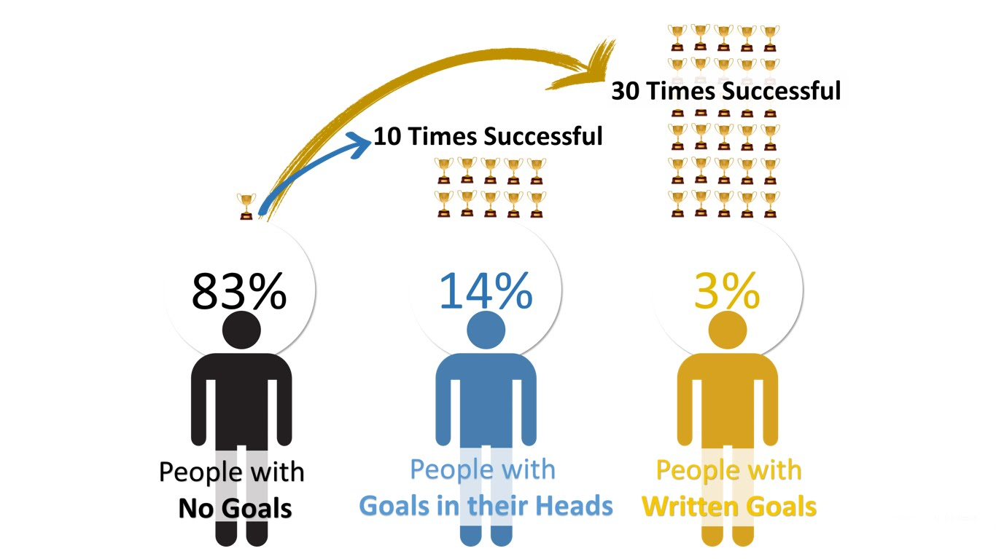
Follow up your goal!!!
https://financesonline.com/tips-writing-goals-increase-productivity-work/

Slide 3

Notes:
Lets share your goals with your friends in a very short sentence & easy to remember.
Format:
Your name
Your current work
Your goal in short sentence

Slide 4
Agenda
Semantic Layout
Introduction to Path
Links
Image, Audio, Video
Iframe
HTML Entities
Q & A

Slide 5
Semantic Layout

Slide 6
Semantic tags
Need | Use tag
Header | header
Divide content into sections | section
Multi-media | audio, video
Footer | footer
An article | article
An aside | aside
Main content | main

Slide 7
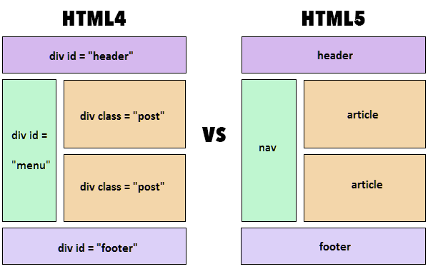
Semantic layout

Slide 8
What is URL?

Slide 9
Absolute vs Relative URL
Absolute https://nordiccoder.com/app/themes/wp-bootstrap-starter/images/Logo_NC.svg
Relative uploads/2017/06/logo.png ../uploads/2017/06/logo.png /uploads/2017/06/logo.png

Slide 10
Which tags use URL?

Slide 11
Tags using URL
Tag | Use for
img | Image
a | Link
audio | Audio
video | Video
iframe | Embed

Slide 12
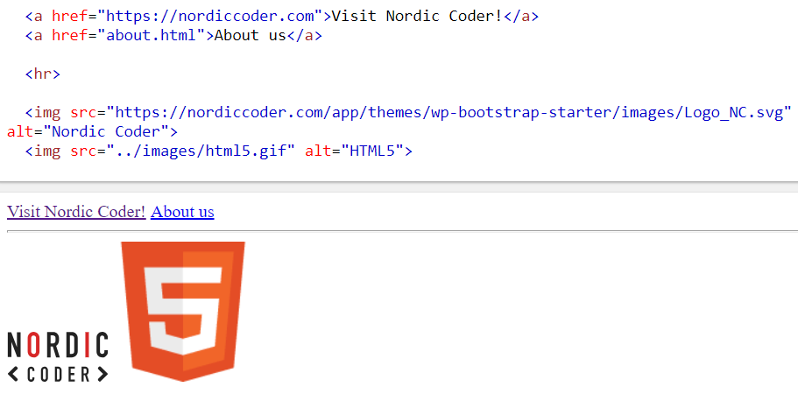
Link & Image

Slide 13
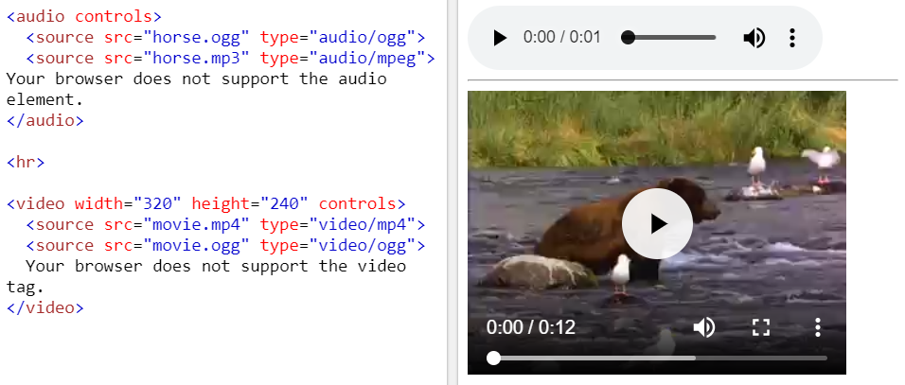
Audio & Video

Slide 14
Supported audio type
Format | MIME-type
Mp3 | audio/mpeg
Ogg | audio/ogg
Wav | audio/wav

Slide 15
Supported video type
Format | MIME-type
Mp4 | video/mp4
WebM | video/webm
Ogg | video/ogg

Slide 16
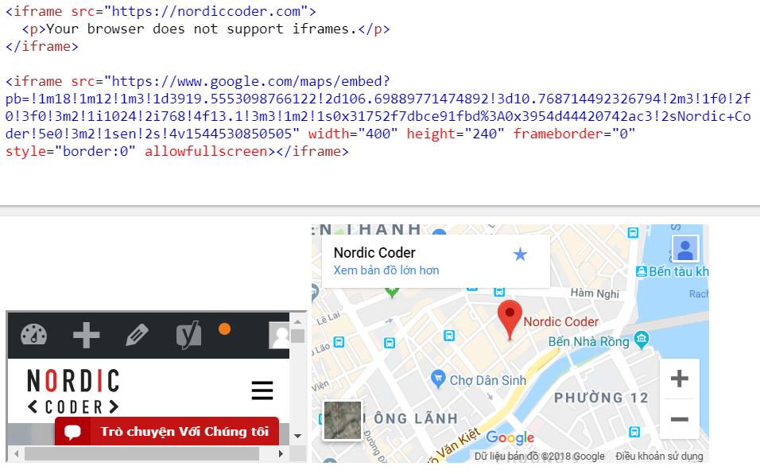
Iframe

Slide 17
What is HTML Entities?

Slide 18
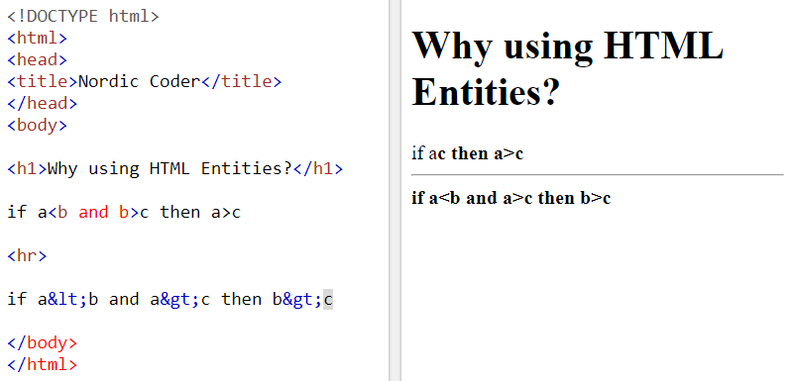
Why HTML Entities?

Slide 19
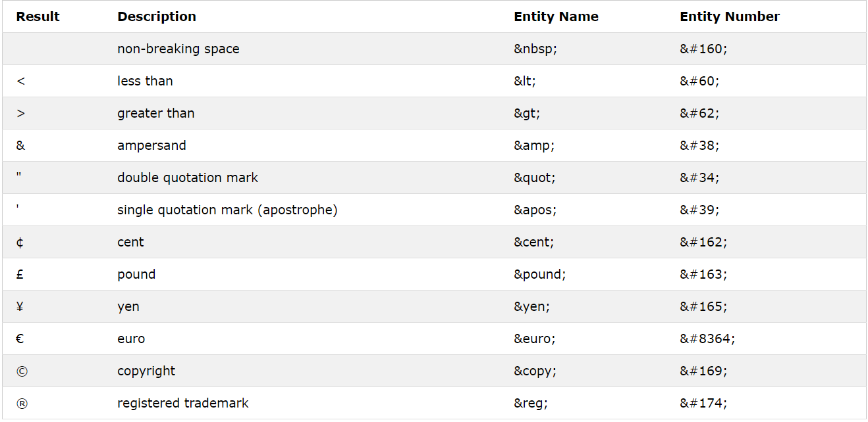
HTML Entities
https://www.w3schools.com/html/html_entities.asp

Slide 20


Slide 21
Lab
Semantic Layout
Add a link to a website you like
Display audio, video
Embed Youtube video
Embed Google map

Slide 22
Tag of the day

Slide 23


Slide 24


Slide 25


Slide 26

Thank You And see you ;)

